Slide 1
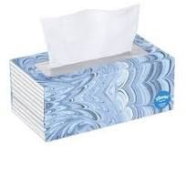
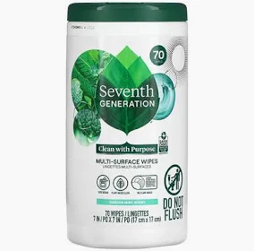
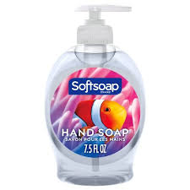
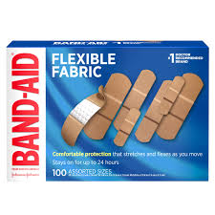
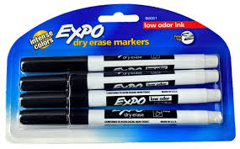
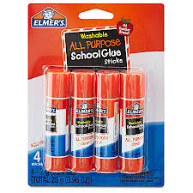
Welcome to Room 127!
I have all of the materials your child will need for the fun activities in our classroom. However, if you would like to donate to our class, here is a list of optional items we always need and appreciate!
Thank you!
-Mrs. Makumbi
Tissues
Disinfectant Wipes
Hand Soap
Band-Aids
Dry Erase Markers
Glue Sticks

